Slide 1
IOT Based Adolescent Handler

Slide 2
Problem Statement
In present scenario, younger generations are did not have time for taking out personally connect with professionals including
Professors, doctors, mentors etc. They cannot even fetch out Community financial services to utilizes complimentary services and budget.

Slide 3
Solution proposed
With built-in portal, online appointments, group chat portals, automated financial approvals, online healthcare will enable student to have spare time to enjoy their lives with friends and family.

Slide 4
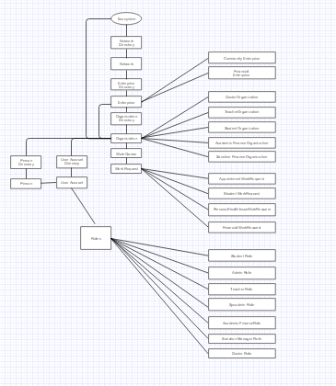
Object Model Diagram

Slide 5
Roles:
HealthCare
Teachers/Mentors
Academic Financial Service
Student
Sanction Manager Financial Service

Slide 6
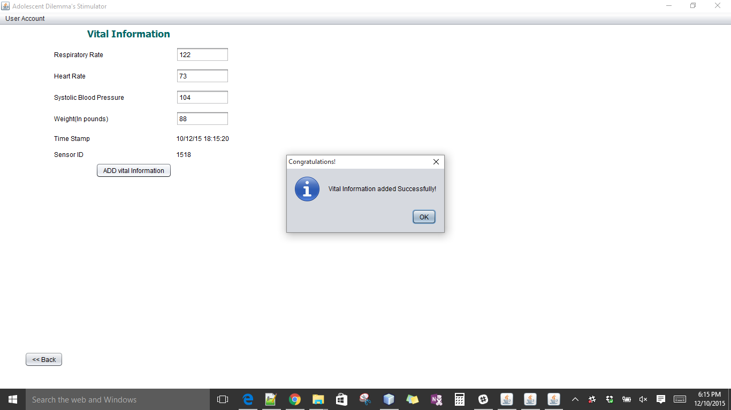
IoT
Implemented IoT in Vitals Sign collection and in loan amount decision making.

Slide 7
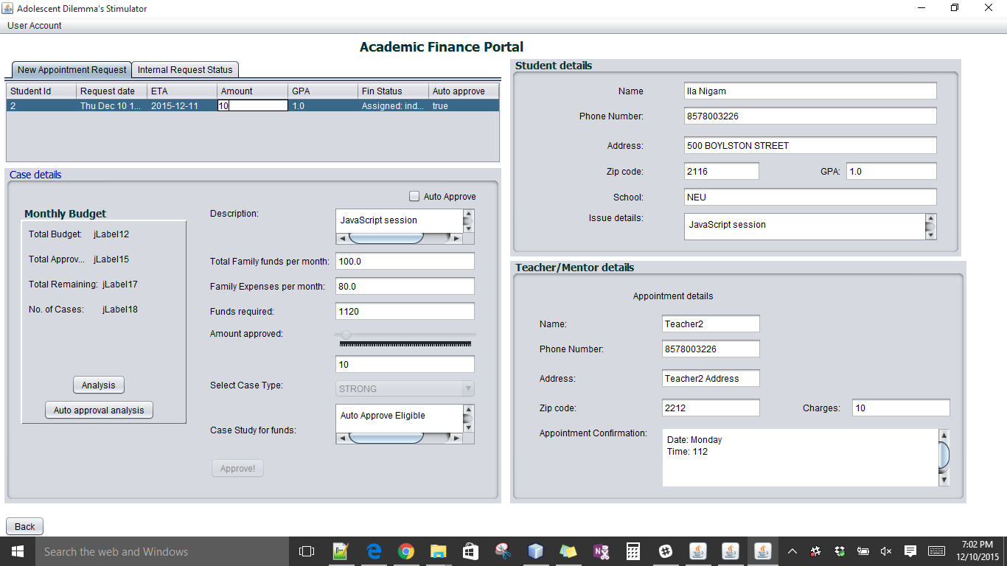
IoT Finance

Slide 8
Use Case:
Automated health records transfer to doctor, if case vital signs goes Abnormal
Doctor online consultation
Sending nearest doctor details to sick student via SMS.
Online portal to lookup doctor and discussing problems.
Sending result notification via Email
Plotting doctor’s location on map using google maps.
Student group chat portal with notification
Automatic approval for Student with family income below certain wage

Slide 9
Use Cases..
Symptoms guidance
Book suggestions
Implemented emotion gauge and played audio for happy moments
Student can check fire hazards videos incase of emergencies.
Implemented password strength and progress bar to show status of appointments.

